Slide 1
DesignDeck : New Features & Recent Progress
DesignDeck is a collaborative portfolio platform where designers and developers can showcase their work through interactive project uploads. The platform allows users to create and manage portfolios, upload images and videos, and display projects on their profile.
Designed and developed by : Patel Twinkle , Harsh Vekariya
Instructor : Honey Patel
CPC - GU
04-04-2025

Slide 2
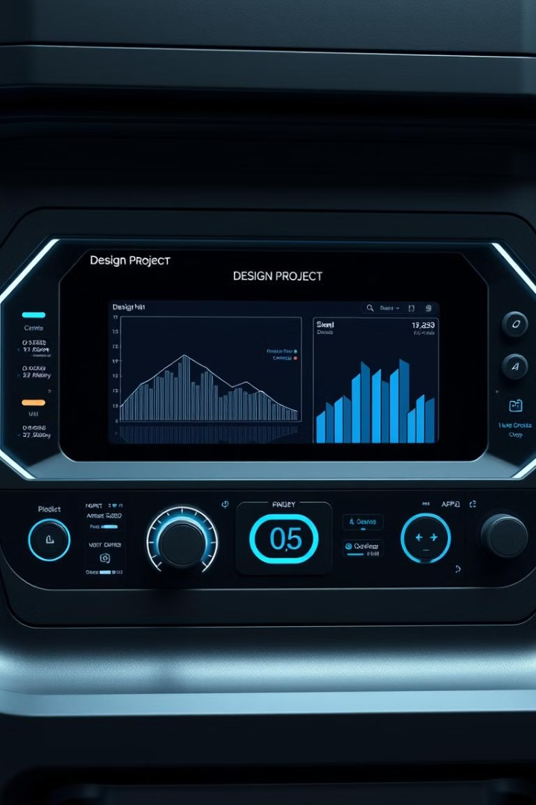
Project Objectives
1
Seamless Portfolio Management
Create a fluid platform for managing design portfolios.
2
Robust User and Admin Features
Provide powerful user and admin management capabilities.
3
Scalable Design Showcase
Develop a scalable, user-friendly design showcase tool.
4
Easy Project Uploading
Enable simple project uploading and profile customization.

Slide 3
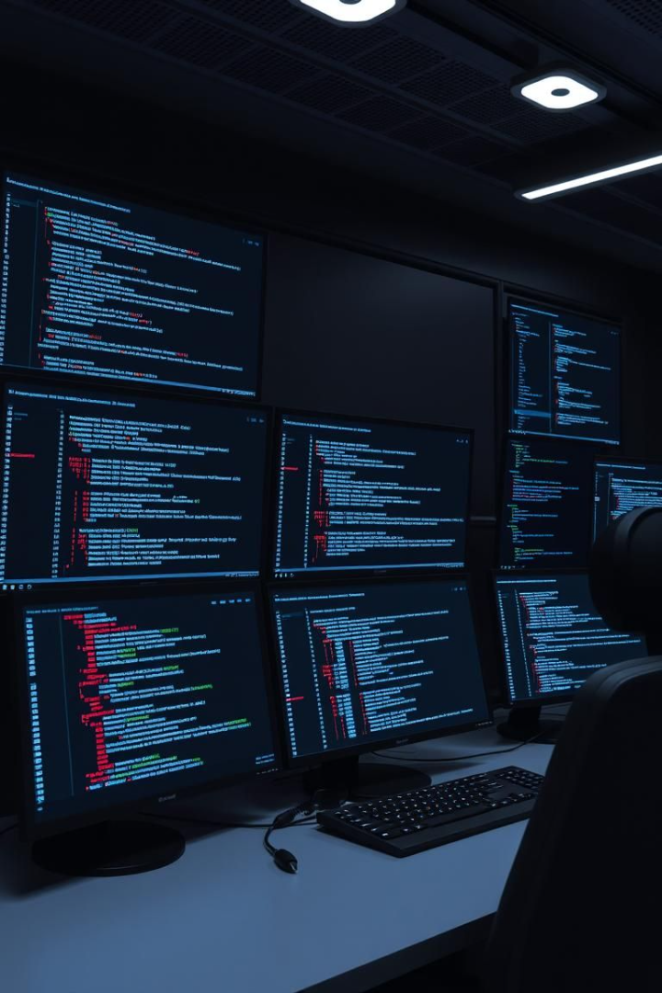




Technical Methodology: MERN Stack
MongoDB
Express.js
React
Flexible document storage
Robust backend routing
Dynamic frontend
Node.js
Server-side performance
The MERN stack provides the scalability and flexibility needed for DesignDeck. Microservices architecture allows for independent scaling and maintenance.

Slide 4



Recent Progress: Key Milestones
Project Portfolio Upload
Profile Editing
Admin User Management
Users can now create portfolios with images & videos file types.
Users can customize profiles with professional networking.
Admins have comprehensive user oversight and management.

Slide 5



User Experience Design
1
Intuitive Interface
2
Clean Design
3
Responsive
DesignDeck focuses on an intuitive drag-and-drop portfolio creation. The interface is clean and minimalist. Responsive design ensures seamless project management on mobile and desktop.

Slide 6
Admin Control Center
User Management
View all user, check active status and last login time.
Role display
Show roles as User or Admin for clear identification
User Deletion
Admin can delete a user if necessary for platform management

Slide 7



User Management Features
Role Assignments
Granular role assignments for precise control.
Profile Verification
Profile verification for secure accounts.
Privacy Control
Privacy control settings for user data.

Slide 8
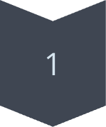
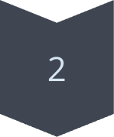
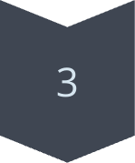
Project Upload & Portfolio
Unlimited Projects
Showcase unlimited projects.
High-Resolution Media
Supports high-resolution media.
Customizable Layouts
Customizable portfolio layouts.

Slide 9
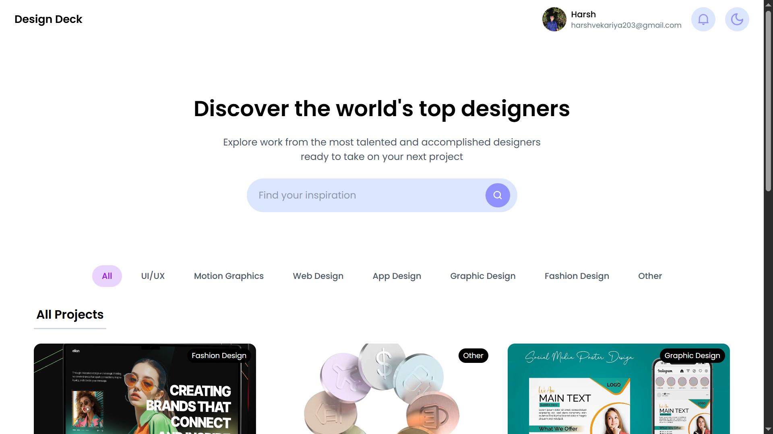
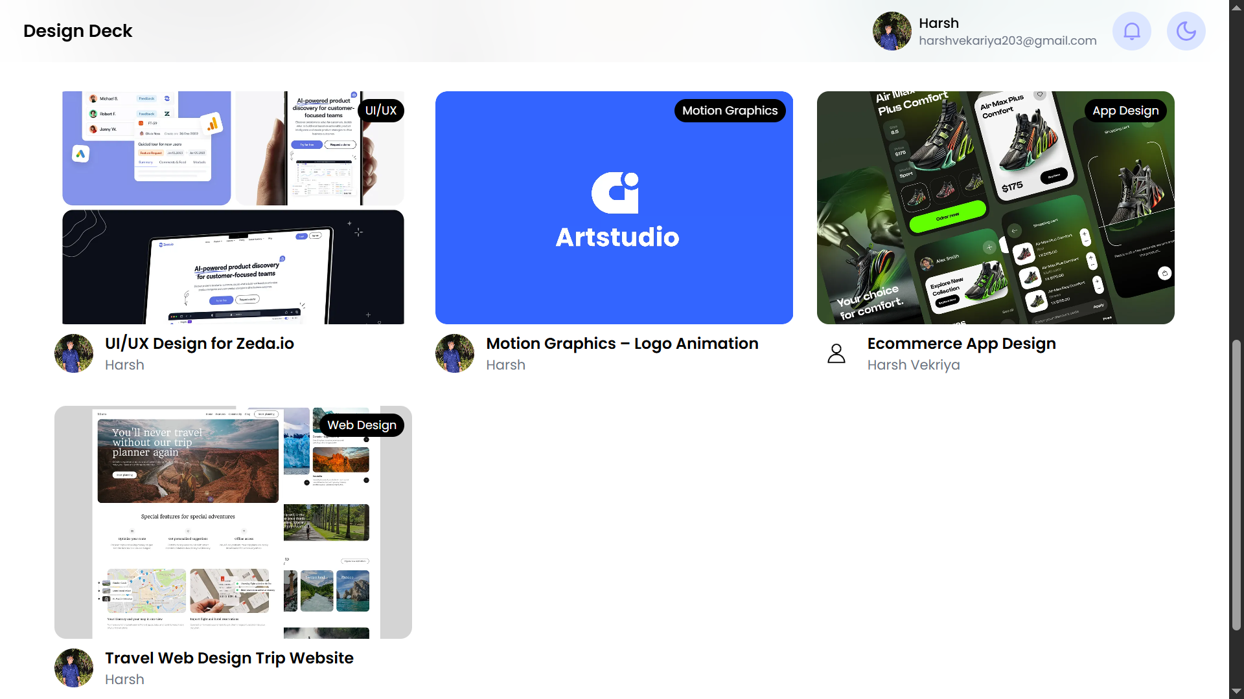
Dashboard
Show all projects

Slide 10
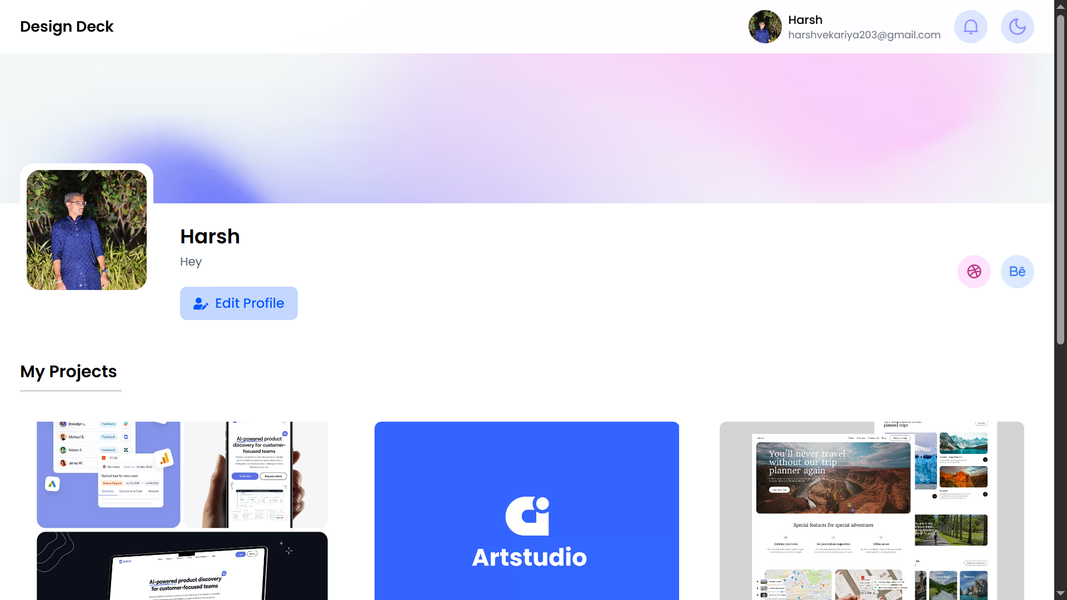
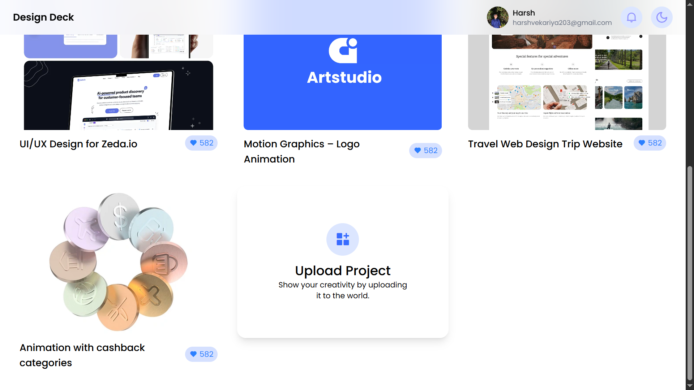
Profile Page
Show users all project & edit profile

Slide 11
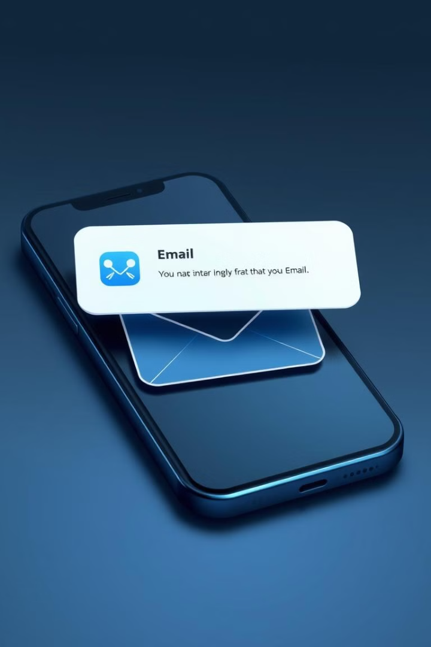


Email System
Email System
Implement a mailing system. Admins can send mail to all users.
Notifications
Develop a notification system. Keep users informed and engaged.

Slide 12
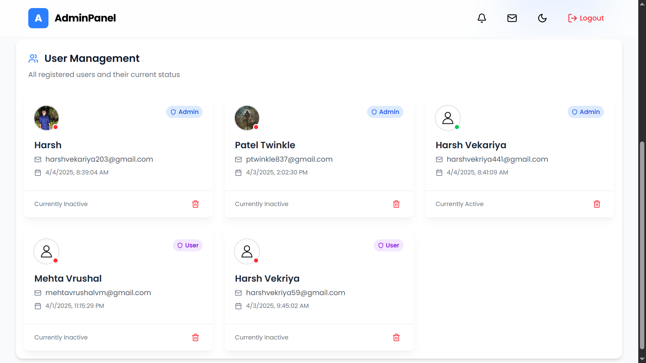
Admin Panel : User Management

Slide 13
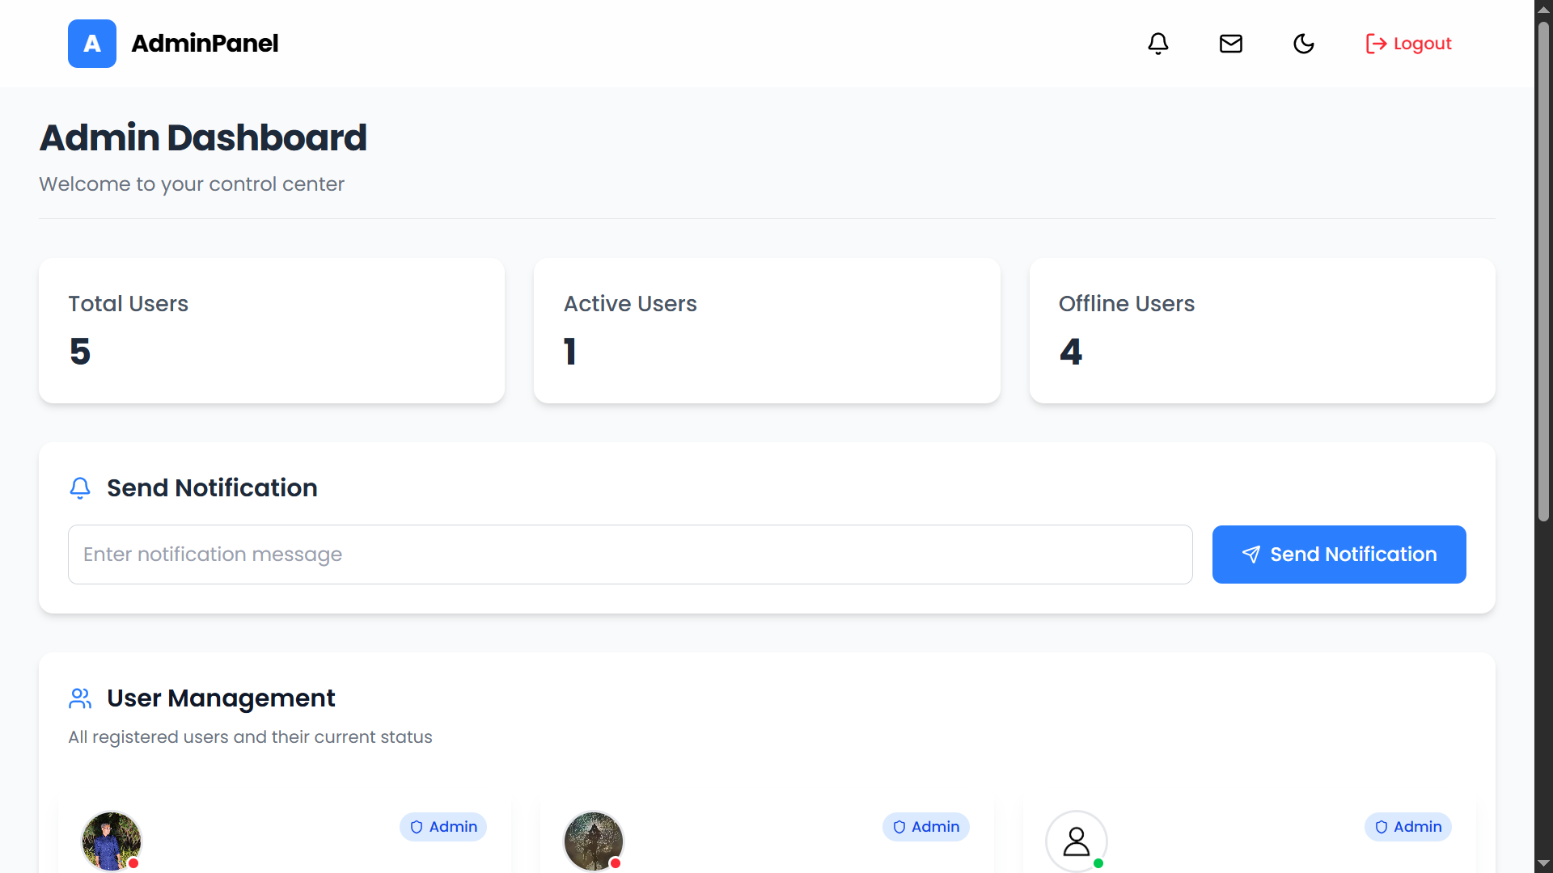
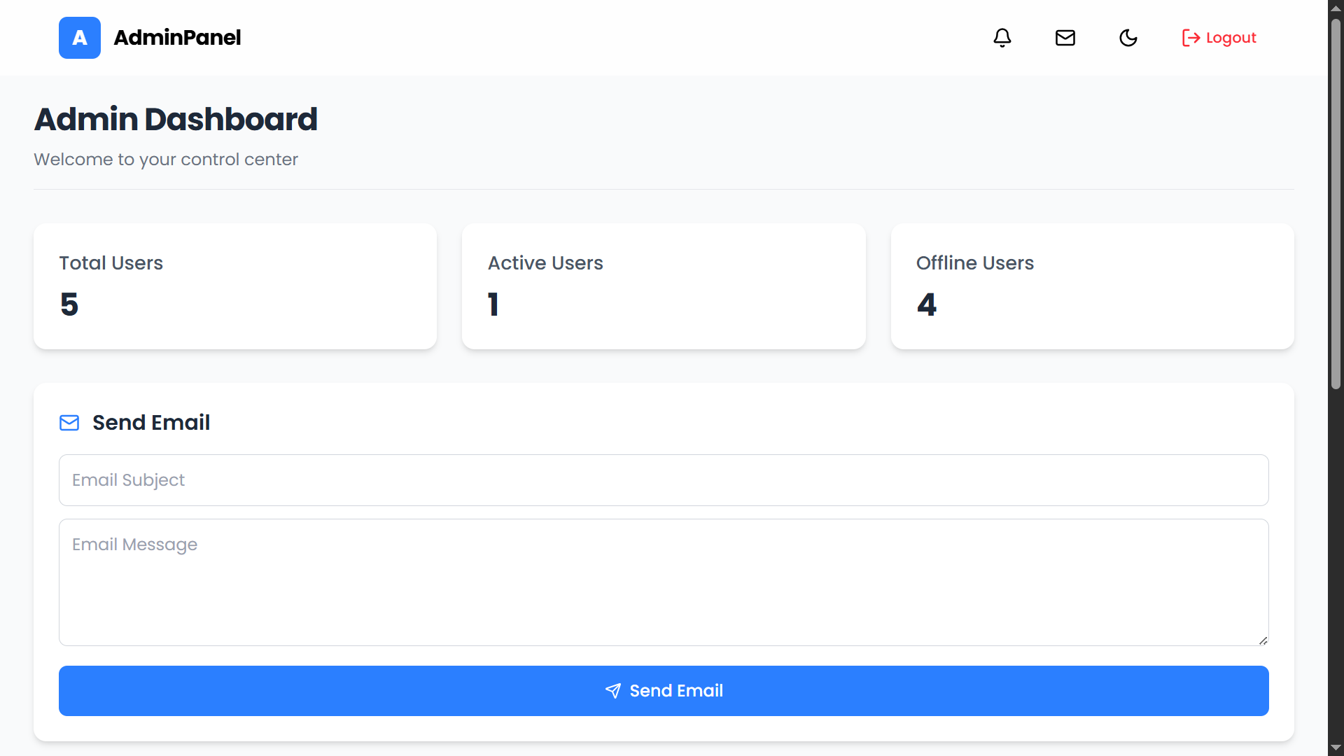
Admin Panel
Notification System
Mail System

Slide 14
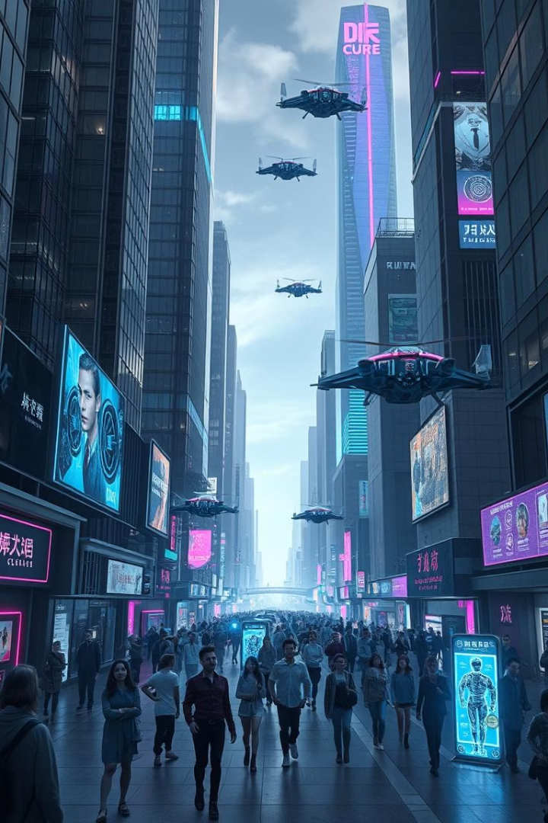



Next Steps and Call to Action
Here's what's next for DesignDeck:
Complete Backend Development
Backend fully implemented with all features
User Testing
Evaluating user experience and functionality
Public Live
Project deployed and accessible to users

Slide 15
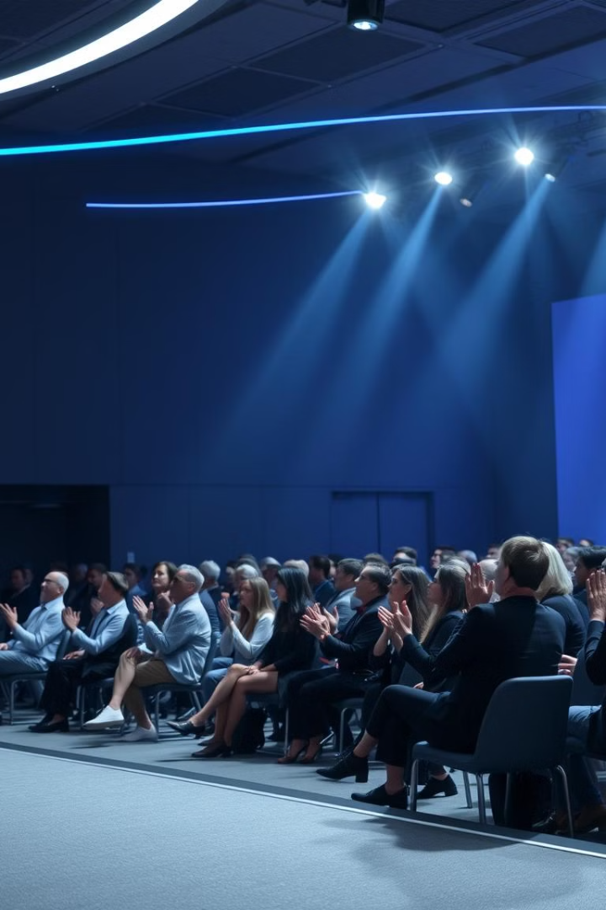
Thank You
Thank you for your time and consideration.
We're excited about the future of DesignDeck!

